Slide 1

Project Status
Algorithmic Trading with Deep Learning
Ritesh Kumar

Slide 2
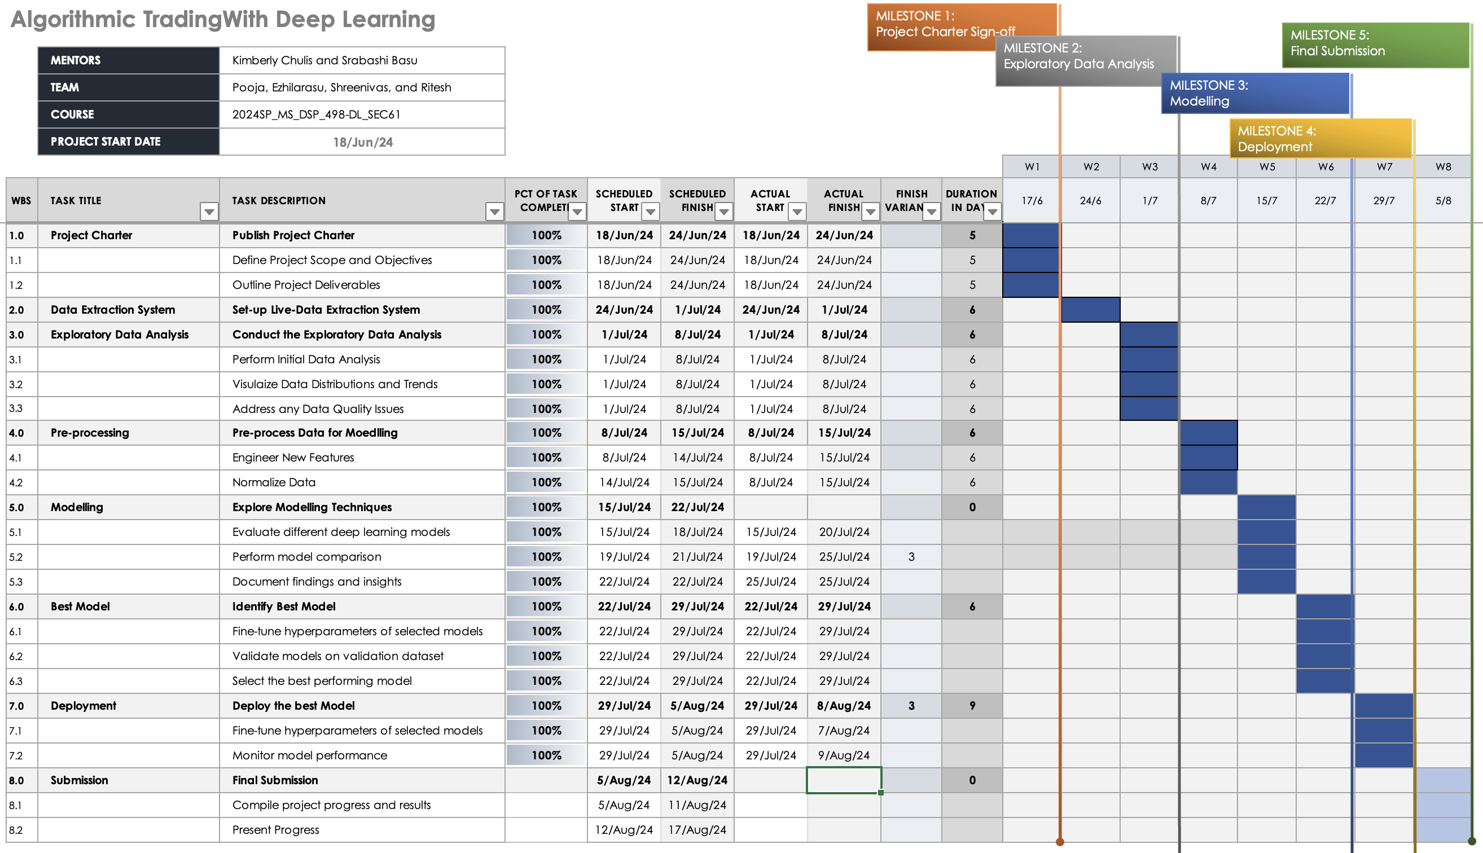

Slide 3



Project Status - Continued
PRE-PROCESSING AND FEATURE ENGINEERING
DATA NORMALIZATION
EXPLORE MODELLING TECHNIQUES
Pre-process data and create new features from the raw data to improve model’s performance.
Covers the importance of data normalization and the techniques used to ensure the data is on a consistent scale.
Explored CNN, LSTM, and Transformers with different combinations of hyperparameters.
THE PRE-PROCESSING TASKS, INCLUDING FEATURE ENGINEERING AND DATA NORMALIZATION, ARE CRUCIAL STEPS IN THE PROJECT'S PROGRESS. THESE STEPS ENSURE THE DATA IS PREPARED FOR THE SUBSEQUENT ALGORITHMIC TRADING MODEL DEVELOPMENT.

Slide 4
Project Status - Continued
IDENTIFY BEST MODEL
DEPLOY BEST MODEL
FINAL SUBMISSION
Identify the best model, fine-tune the hyperparameters of the selected models, then validate these models on a test dataset, and finally, select the best performing model.
Fine-tune the hyperparameters of the selected model, deploy the best model, and monitor the model's performance.
Integrate live trading, observe and fine-tune project performance, compile the project progress and results, and present the progress.
IDENTIFY AND FINE-TUNE THE BEST MODEL, VALIDATE IT ON A TEST DATASET, THEN DEPLOY AND MONITOR THE MODEL'S PERFORMANCE. FINALLY, INTEGRATE LIVE TRADING, FINE-TUNE PROJECT PERFORMANCE, COMPILE PROGRESS AND RESULTS, AND PRESENT THE PROGRESS.

Slide 5




Progress
DATA COLLECTION
FEATURE ENGINEERING
A comprehensive dataset of 9,471 records capturing BankNifty's 1-minute movements—encompassing index and options chain with 47 features—was compiled from June 24th to July 31st. These relevant market indicators lay a robust groundwork for the ensuing analysis.
As no single feature showed substantial correlation with Index movements, a diverse set of features, including technical indicators, was engineered to capture the complexity of BankNifty movements.
EXPLORATORY DATA ANALYSIS
MODELLING
Extensive exploratory data analysis was conducted, revealing patterns, trends, and insights. It was discovered that movements greater than 11 points (25th and 75th percentiles) in either direction significantly influence trading decisions.
LSTM, Transformers, CNN, XGBoost, GRU, and Ensemble models were explored, each with a diverse set of hyperparameters. CNN models emerged as the best performers.
BANKNIFTY'S 1-MINUTE MOVEMENTS WAS ANALYZED, REVEALING NO SINGLE FEATURE SUBSTANTIALLY CORRELATED WITH INDEX MOVEMENTS, LEADING TO THE ENGINEERING OF DIVERSE FEATURES INCLUDING TECHNICAL INDICATORS. EXPLORATORY DATA ANALYSIS AND EXPERIMENTATION WITH VARIOUS MODELS IDENTIFIED CNN AS THE BEST PERFORMER, ESPECIALLY FOR MOVEMENTS GREATER THAN 11 POINTS, WHICH SIGNIFICANTLY INFLUENCE TRADING DECISIONS.

Slide 6
Training the Final Model
Data Preparation: The data was normalized to the range [-1, 1], with the last 30 datapoints taken into account. The test set comprised the last day of data, while the train and validation sets followed an 80:20 split.
TensorFlow Estimator Configuration: The TensorFlow estimator was set up using the `cnn_ver1_model.py` script, with a single instance of type `ml.m5.2xlarge`.
Hyperparameters: The model was fine-tuned with the best hyperparameters, including six epochs, a learning rate of 0.00057, a batch size of 133, and a seed value of 42 to ensure reproducibility.
Training Execution: The training process leveraged SageMaker's capabilities to refine and validate the convolutional neural network's performance.
Results: The training resulted in a best validation mean squared error (val_mse) of 0.01, underscoring the model's accuracy and robustness.
Deployment: The final model has been deployed as an endpoint at an ml.m5.large instance, and accessing the endpoint has been successfully validated.

Slide 7
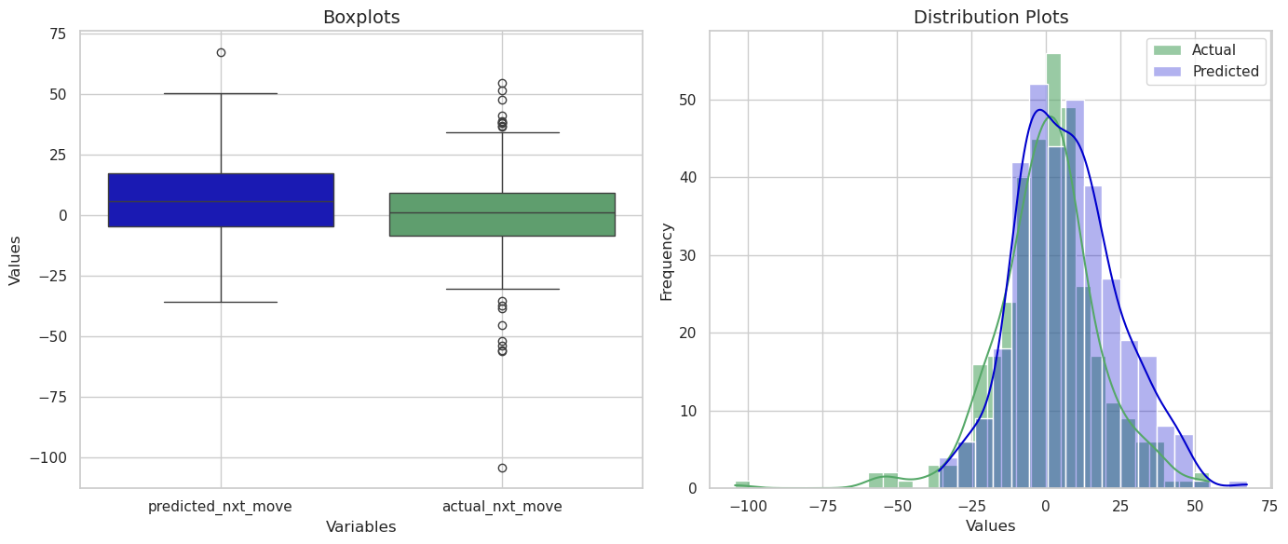
Final Model
The boxplot shows that predicted values have a narrower range and fewer outliers compared to actual values.
The distribution plot indicates that predicted values closely follow the actual values' distribution with minor deviations.
The model's predictions generally align with the actual data, but it has not been able to predict the outliers.

Slide 8
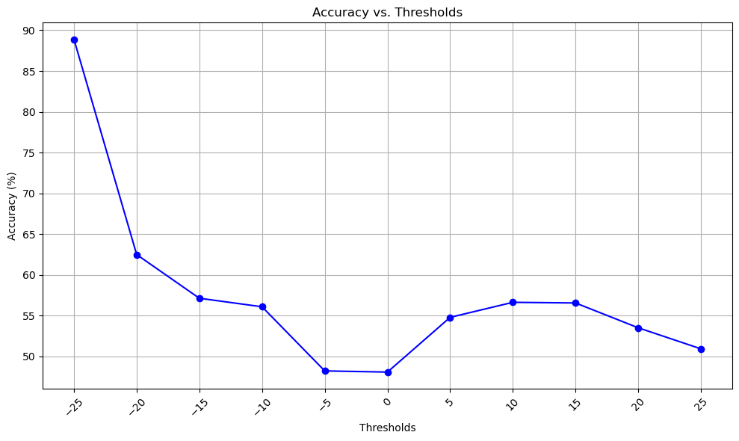
Final Model
Larger movements, between 10 and 20 points, in either direction, the accuracy of prediction is around 55%.
At the extreme negative threshold (-25), the model achieves the highest accuracy of around 90%.
The accuracy fluctuates around 50-60% for positive thresholds, showing no clear upward or downward trend.

Slide 9
Integration
Update initial variables from the Index and Option Chain data streams in a dataframe.
Compute technical indicators from the last 60 rows.
Run three threads: one for the index, one for the option chain, and one for trading.
Continuously write the dataframe to disk.
Use the predictor endpoint to forecast the next movement based on the last 30 one-minute intervals.
If the predicted movement exceeds 11 points, initiate trading in the appropriate direction using the pygmitized script.

Slide 10
Thank You

